Slide 1
Block Renovation
Take Home
Sandro O’Neill
Sept 15th, 2022

Slide 2
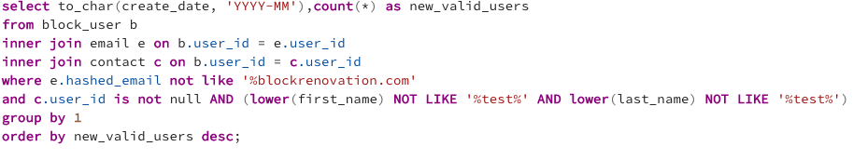
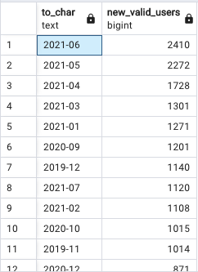
Task #1 - Valid User Counts by Month
Valid User Criteria:
Email not ending in blockrenovation.com
Valid User ID assigned in email table
‘Test’ not in first/last name
Method & Output:
Year-Month periods with valid users registration counts using datetime conversion (to_char) and count aggregate
A ‘TOP’ or ‘LIMIT’ clause could be added to only retrieve the row with the highest new users, June 2021

Slide 3
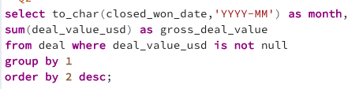
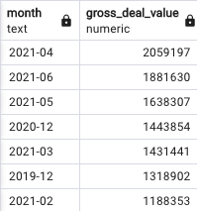
Task #2 - Highest Gross Deal Value
Deal Criteria:
Non-null value in the Deal_Value_USD column
Method & Output:
Similar to Task #1, the datetime column (closed_won_date) was converted to Year-Date format
Sum aggregate used to calculate monthly totals and ordered in descending.
Same as Task #1, A ‘TOP’ or ‘LIMIT’ clause could be added to only retrieve the row with the highest gross deal value, April 2021

Slide 4
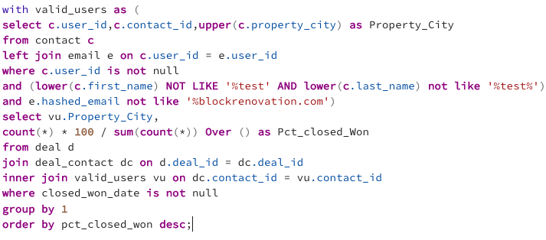
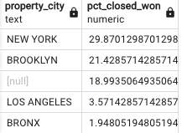
Task #3 - Percentage of Closed Deals by city
Criteria:
Assigned “closed won” deal date
Valid user assigned (similar to Task #1)
Method & Output:
Created the “valid_users” CTE using the query from Task #1 to generate valid user list with contact_ids and associated cities.
Joined “deal” table to bridge table “deal_contact” and CTE to filter to only valid users.
Used the sum and count (along with over clause) aggregate functions to calculate percentage of deal counts relative to total.
A snapshot of the output can be seen to the right.

Slide 5
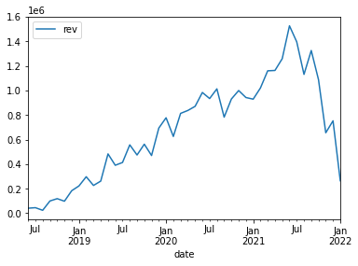
Task #4 - Monthly revenue with adjusted timeline
Approach:
Exported distinct deal ids, contract won dates and value amounts from Deals table in csv format
Read in csv file, analyzed and transformed using Python in Jupyter notebooks
Method & Output:
Using a for loop, iterated through the 3 points each project goes through, while adjusting date and revenue columns using 3 month intervals and revenue weights. Appended all into a single dataframe object.
Used a group by sum aggregate to transform combined dataframe into a time series object.
Determined maximum revenue month to be June, 2021 at $1,526,444.
Full details in Jupyter Notebook file

Slide 6
Findings & Analysis
Based off of the provided data, the Second Quarter of 2021 was especially successful for block both in terms of revenue and platform growth:
Highest number of valid users created in June 2021
Highest gross deal month was April 2021
Highest revenue month (with adjusted timeline) was also in June 2021
Additionally we observed the revenue graph reach its highest peak during this quarter before a steep decline in the second half of the year.

Slide 7
Notes & Observations
Looking at the contacts table for Task #3, there were many inconsistencies for the city and state naming conventions along with a large number of missing values.
Some rows had the full state names while most used the 2 letter abbreviations, this is an easy problem to fix if given more time:
For example, update rows in contacts where len(property_state)>2 using a 2 letter to full name table that could be added in
For scalability, a city + state combination would make sense to use to differentiate between same name cities.
Although ‘NEW YORK’ had the highest percentage, ‘Manhattan’ was a present separate value, which makes the output result somewhat misleading.
A DML trigger could be used when non-valid users (such as those with block emails) are added in, or those with “test” as a part of the first/last name. Additionally a boolean valid user column.

Slide 8
Thank you for your time
Sandro O’Neill
sandro.oneill@gmail.com

